Slide 1

Final Presentation
SVBRDF Estimation using a Physically-based Differentiable Renderer Markus Andreas Worchel

Slide 2
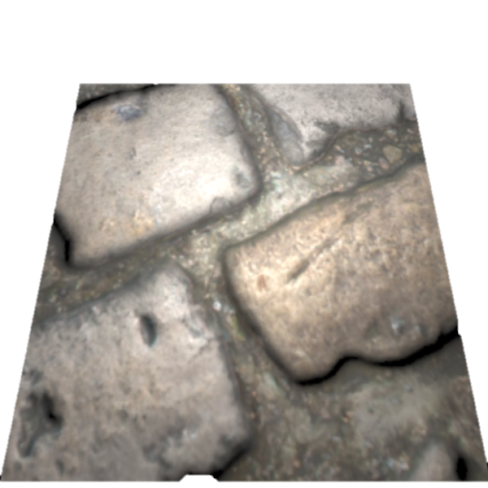
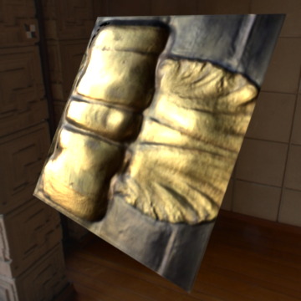
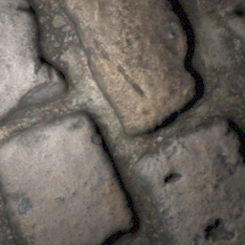
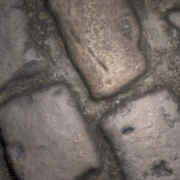
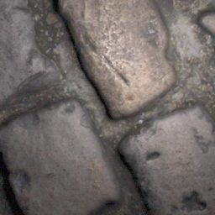
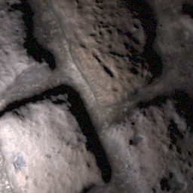
Recap – Topic
Physically-based
Differentiable Renderer
…
CNN
…
…
…
Deschaintre et al., 2018
…
Deschaintre et al., 2019

Slide 3


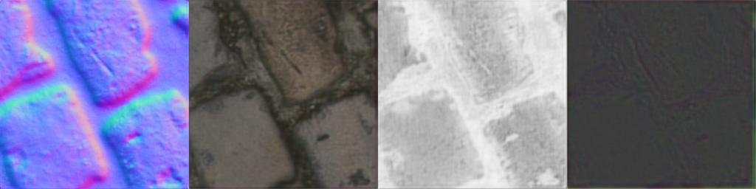

Training Loss
Prediction
Ground Truth
CNN
…
…
…
?

Slide 4
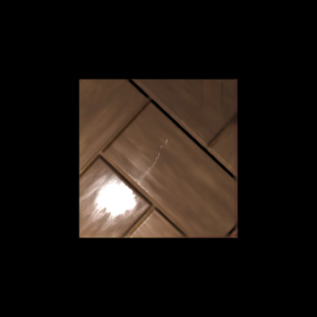
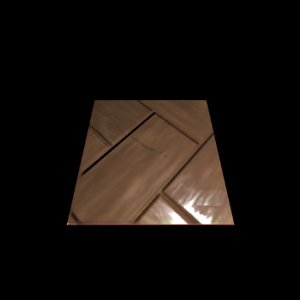

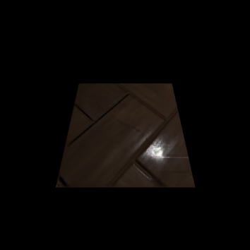

Loss
$$λ$$
-
+
-

Slide 5
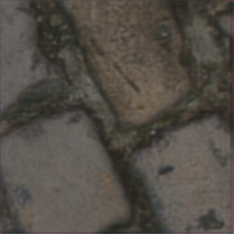
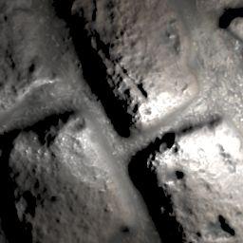
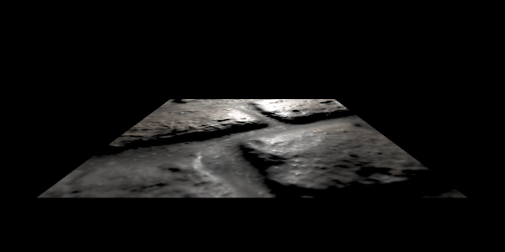
Rendering Loss
Implement simple differentiable renderer ✓
Only considers direct illumination
Lambertian diffuse term
Cook-Torrance specular term
Renders SVBRDF on flat material patch in the origin (virtual orthographic view)
💡
📷
Perspective
Orthographic

Slide 6
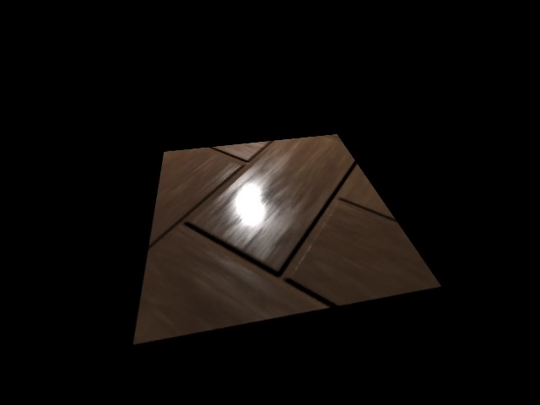
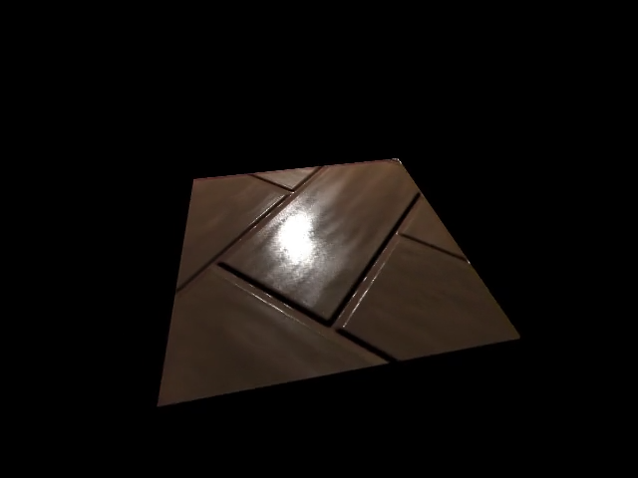
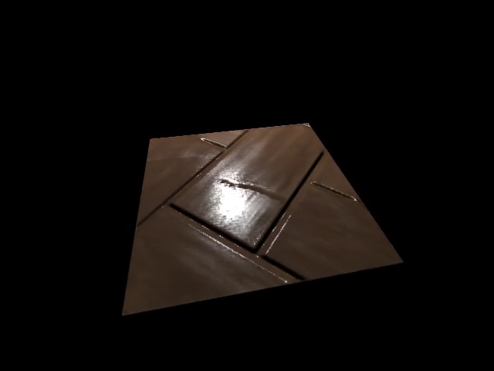
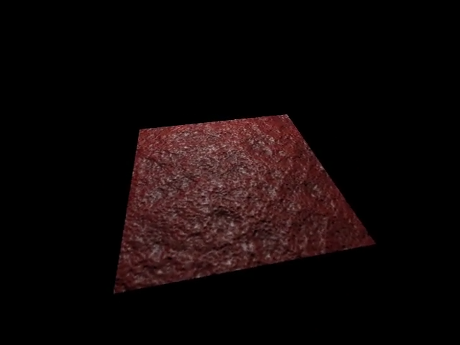
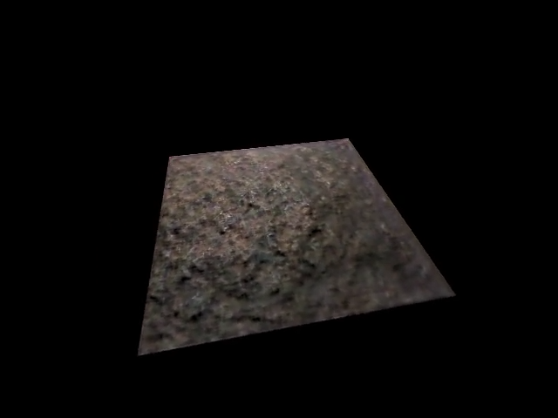
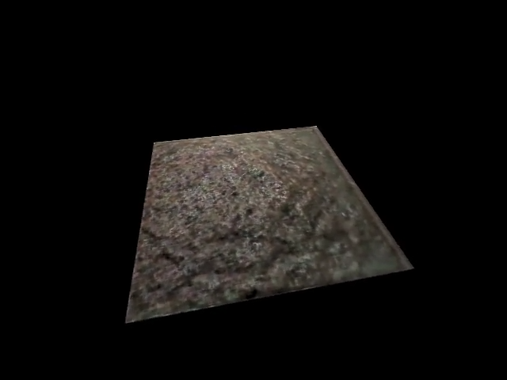
Loss – Results
Input
Ground Truth
L1 Loss
Mixed Loss (L1 + Rendering)
Notes:
2 training samples
3000 Epochs

Slide 7
Replacing the Simple Renderer – Challenges
Integration into rendering loss and current structure –
Redner scene definition vs. my scene definition
Virtual orthographic rendering
Training time feasibility check –
Path tracing is resource and time demanding
GPU implementation is probably a must
Evaluation –
Full training of models
Qualitative (and quantitative) comparison
Training time comparison

Slide 8
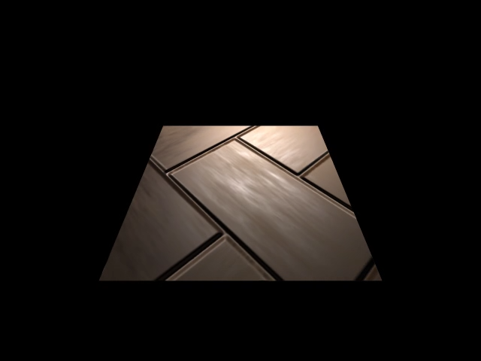
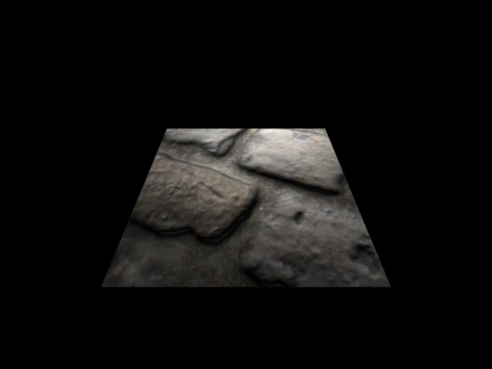
Conclusion
Still some work to do… …but most difficult tasks are finished or basis is established
Redner in action (path tracing our SVBRDFs):

